Slide 1
Cash Reserves and Short-Term Debt Under Liquidity Constraints
O’Neill School of Public and Environmental Affairs
Luis Navarro
Presentation for the ABFM Conference 2024
INDIANA UNIVERSITY BLOOMINGTON

Slide 2
Introduction
Research Question: What is the effect of cash reserves on short-term borrowing?
Theory: Liquidity constraints play a crucial role in determining the relationship between cash reserves and short-term borrowing (Kling, 2018). Depending on the stringency of the constraint, cash and debt might behave like substitutes or complements.
Empirical Analysis: Mexico’s fiscal system provides a setting with liquidity-constrained state governments facing liquidity shocks from timing errors (exogenous variation!) on federal IG transfers.
Notes:
At first sight, the relationship between these variables is not straightforward.
If the government is helping you, is because you might need it.

Slide 3

Findings Preview: cash and debt behave like complements!
Estimated Effect: ⬆️ 1 SD on Cash Reserves (% Discretionary Revenues, DR) ≈ ⬆️ 3.75% of DR in outstanding short-term debt. Effect Size (Implied Elasticity): 0.6 SD of outstanding ST Debt
Mechanisms and Liquidity Management
Cash Reserves: stronger effects for less capitalized states (Eff size = 0.8 SD)
Temporal Heterogeneity: stronger effects closer to the beginning/end of fiscal year. Cash-flow management of non-deferrable expenses.
Credit risk: larger effects for lower rated governments. Evidence on the stringency of liquidity constraints.
Implication: Liquidity-constrained governments might prefer to manage cash-flows via short-term debt , even if they face a high interest rate.
Notes:
At first sight, the relationship between these variables is not straightforward.
If the government is helping you, is because you might need it.

Slide 4
Theoretical Motivation: Liquidity Constraints
Without Liquidity Constraints
Cash and debt behave like substitutes.
Pecking order theory: Organizations prefer internal over external financing. Debt carries interest and opens the door to the scrutiny of third parties (Jensen, 1986; Myers, 1984).
Implication: finance liquidity gaps with cash reserves.
Under Liquidity Constraints
Relationship is ambiguous. Empirical question!
Cash reserves have an operational and precautionary role (Kling, 2018). Governments maintain cash reserves to preserve creditworthiness (Marlowe, 2011) and signal solvency to access financial markets.
Implication: finance liquidity gaps with short-term debt.

Slide 5
Fiscal Federalism in Mexico: Liquidity Management Implications
Empirical Setting: Mexican state governments (2018-2022).
Low fiscal flexibility: for each dollar states have, they have spending discretion on 50 cents, but ≈ 90 cents must go to cover current expenses + transfers to local governments. Persistent fiscal deficits: -3.5% of total revenues (average, 2000-2022).
Implication: state governments observe reduced space to generate excess cash-flows and have few tools under the belt to cope with liquidity shocks.

Slide 6
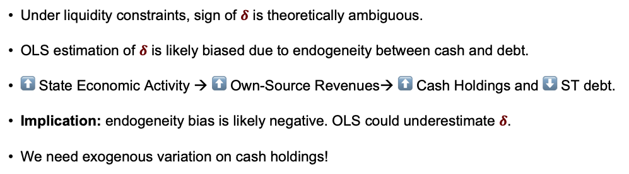
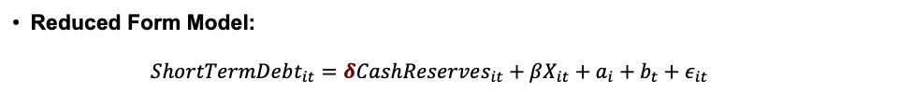
RQ: What is the effect of cash reserves on short-term borrowing?
Reduced Form Model:
$ShortTermDebt_{it}=δCashReserves_{it}+βX_{it}+a_{i}+b_{t}+ε_{it}$
Under liquidity constraints, sign of $δ$ is theoretically ambiguous.
OLS estimation of $δ$ is likely biased due to endogeneity between cash and debt.
⬆️ State Economic Activity → ⬆️ Own-Source Revenues→ ⬆️ Cash Holdings and ⬇️ ST debt.
Implication: endogeneity bias is likely negative. OLS could underestimate $δ$.
We need exogenous variation on cash holdings!

Slide 7
Policy Description: General Participations Fund (FGP)
Fiscal Federalism in Mexico: shared-revenue system with centralized tax collection.
General Participations Fund: main discretionary revenues (DR) grant/fund. 75% of total DR, 30% of total revenues.
Distribution across states determined mainly by population. Highly stable over time.
Distribution within the fiscal year determined by the federal government with no clear rules.
States have no influence on the determination of the monthly disbursement calendar.

Slide 8
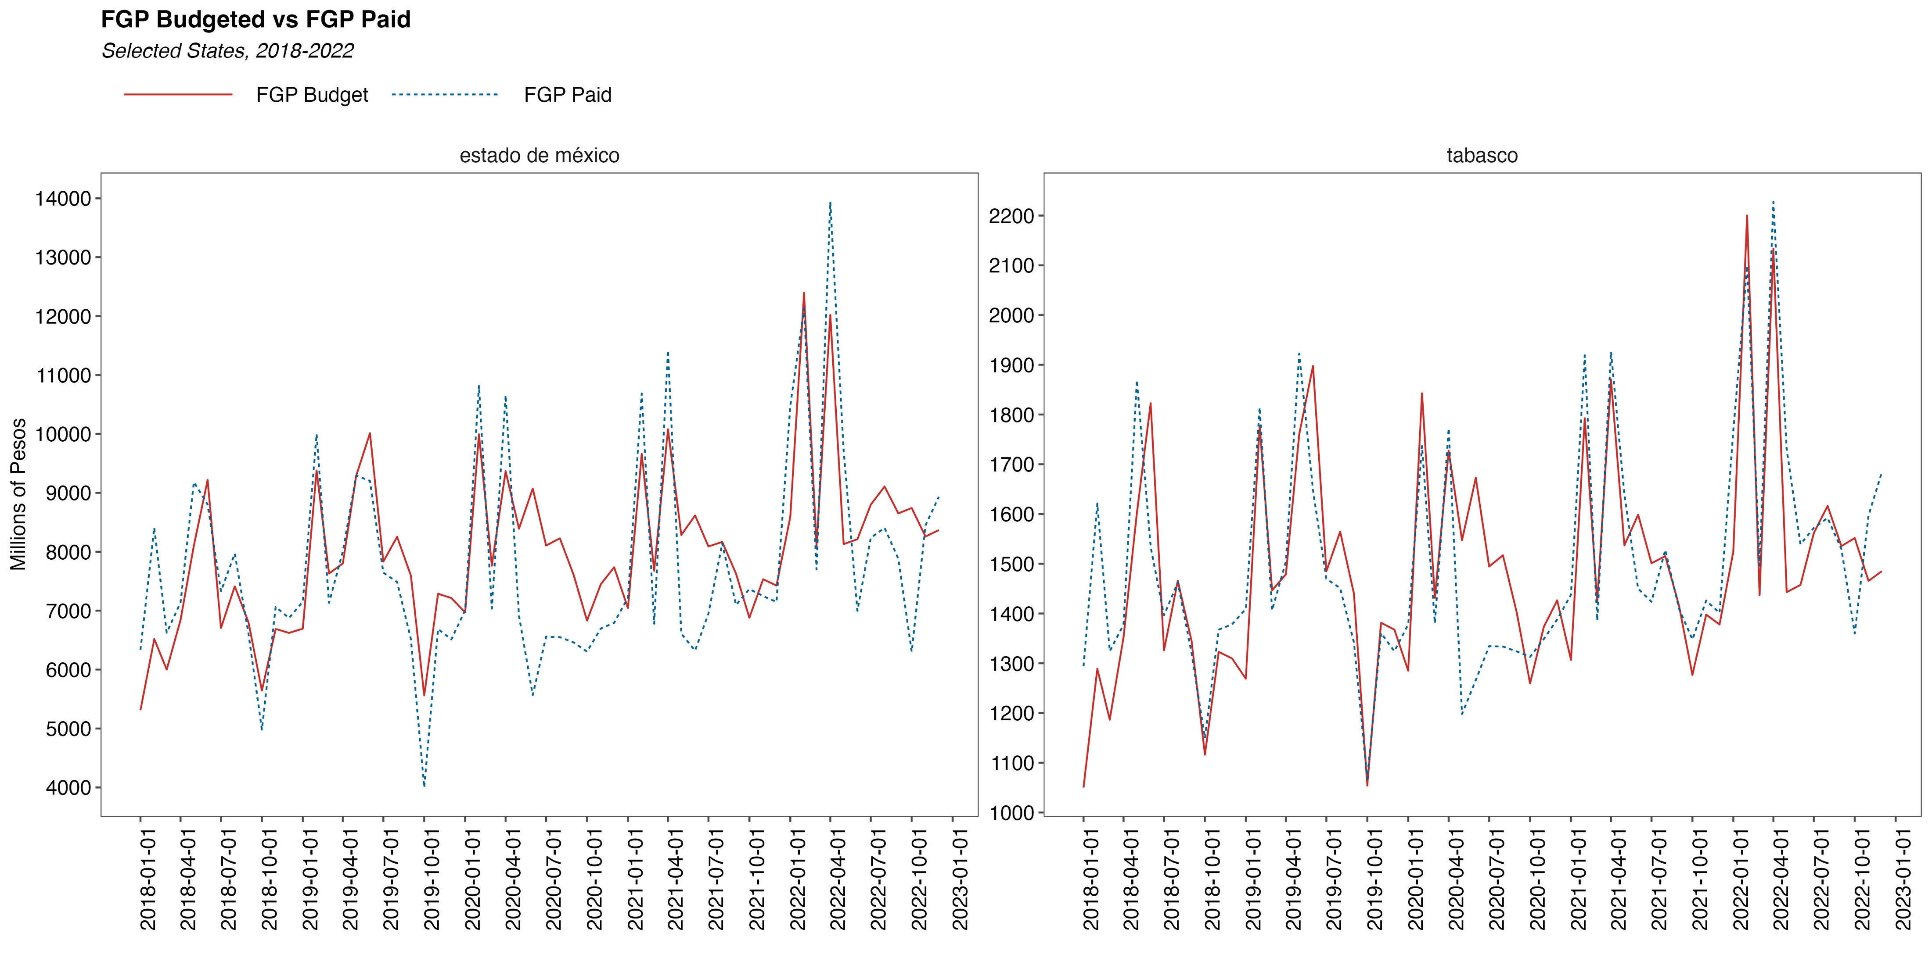
Plausible Exogenous Variation: FGP error
Difference between the budgeted amount and observed transfer within the same fiscal year.
$$FGPError_{it}=FGPPaid_{it}−FGPBudgeted_{it}$$

Slide 9
FGP Institutional Setting
Before the FY begins, federal government discloses the estimated size of IG funds, along with a monthly calendar of disbursements.
States have no say on the calendar nor participate on tax collection. They just incorporate this calendar into their budgets.
However, actual disbursements depend on the observed level of centralized tax collection.
Each month states could observe deviations from their budgeted transfers.
Key: direction and magnitude of these deviations mimics a lottery. For some states, deviations could be positive/negative, regardless of the difference observed at the national level.
Plausibly random component on the federal FGP error to states (i.e., random liquidity shock).
Notes:
I study the quasi-experimental setting created by the CRF using the intuition behind a Regression Discontinuity Design.

Slide 10
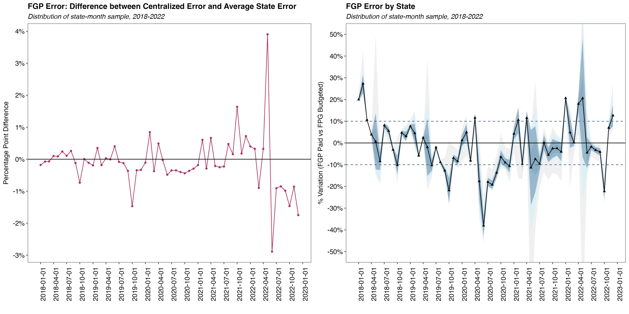
FGP Error Distribution Over Time, 2018-2022
Differences between national FGP error and the average FGP error for states are not systematic.
In any given month, some states FGP error could be positive or negative, regardless of the national error.
Notes: The panel on the left shows the difference between aggregated (national) FGP error and the average state FGP error. The panel on the right shows the distribution of the FGP timing error across time. The solid line represents the mean across states by month-year. The dark-shaded area shows the percentiles between 25%-75%, as well as the area within one standard deviation form the mean, while the light-shaded areas percentiles 1% to 99% (excluding outliers) and 5%-95%. For illustrative purposes, dashed blue lines show the interval between +/- 10% of discretionary revenues.

Slide 11
Research Design
IV Design: Fixed-Effects 2SLS Estimator + Robust-Clustered Standard Errors (State Level)
First stage:
$$CashReserves_{it}=βTimingError_{it}+X_{it}α+a_{i}+b_{t}+ε_{it}$$
Reduced Form:
$$OutShortTermDebt_{it}=δ \hat{CashReserves_{it}} +X_{it}α+a_{i}+b_{t}+υ_{it}$$
Variable Scaling and Coefficient Interpretation
Variables measured as stocks. Outstanding short-term debt and cash-holdings at end-of-Q.
Dependent, endogenous, and instrumental variables expressed as % of average level of DR (2009-2016).
Notes:
I study the quasi-experimental setting created by the CRF using the intuition behind a Regression Discontinuity Design.

Slide 12
Identification
Relevance Assumption: FGP Timing Errors influence the level of cash reserves.
Descriptive Stats: observing a quarterly timing error within one SD from the mean is equivalent to 12% of the average stock of cash reserves.
Formal test: Cragg-Donald test for weak instruments (First stage F stat).
Exclusion Restriction: FGP Timing Errors only influence short-term debt through cash reserves.
FGP annual shares had been historically stable.
Tax collection done by the federal government with no intervention with states.
Monthly calendar is determined by the federal government with no clear rules.
There are differences between national deviations, and the average error observed by states.
Notes:
I study the quasi-experimental setting created by the CRF using the intuition behind a Regression Discontinuity Design.

Slide 13
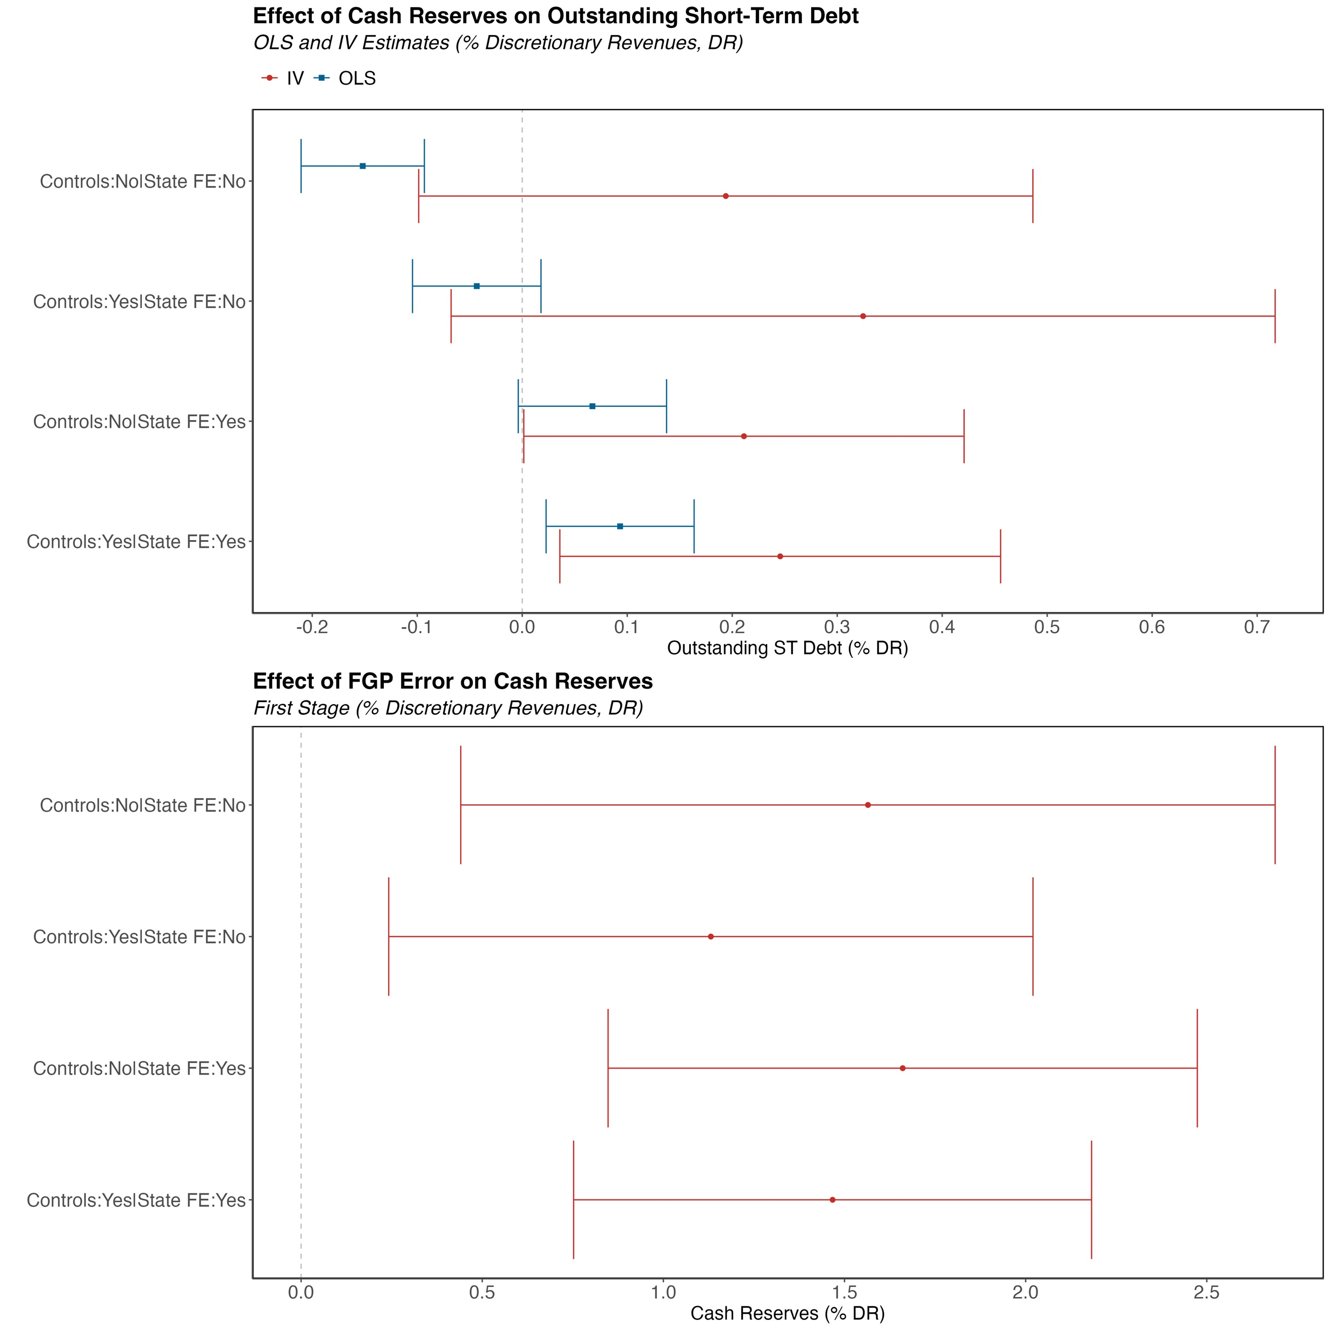
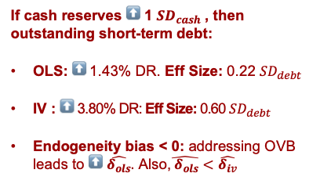
Results
IV Implied Elasticity
If cash reserves ⬆️ 1 $SD_{cash}$ , then outstanding short-term debt:
OLS: ⬆️ 1.43% DR. Eff Size: 0.22 $SD_{debt}$
IV : ⬆️ 3.80% DR: Eff Size: 0.60 $SD_{debt}$
Endogeneity bias < 0: addressing OVB leads to ⬆️ $\hat{δ_{ols}}.$ Also,$\hat{{ δ}_{ols}}<\hat{δ_{iv}}$
0.47
0.79
0.51*
0.60**
FS F-stat
7.41
6.95
30.06
24.20
IV estimates less sensitive to econometric specification.
Strong instrument: Cragg Donald F-Stat > 24
First Stage: a timing error equivalent to 1% of DR leads to an ⬆️ in cash reserves of to 1.46% DR.

Slide 14
FGP Errors do not predict state economic activity.
Exclusion Restriction: FGP errors only influence short-term debt via cash-reserves.
Table: Instrument Validity: Effect of FGP Errors on Local Economic Activity
Dependent Variable | (1) | (2) | (3) | (4)
Unemployment Rate | 0.084 | 0.044 | 0.031 | 0.006
 | (0.076) | (0.036) | (0.023) | (0.024)
Active Taxpayers (% Population) | 0.067 | 0.158 | -0.024 | 0.000
 | (0.460) | (0.226) | (0.041) | (0.031)
Industrial Activity Index | 0.067 | 0.158 | -0.024 | 0.000
 | (0.460) | (0.226) | (0.041) | (0.031)
Quarterly Economic Activity Index | 0.475* | 0.381* | 0.140 | 0.133
 | (0.178) | (0.169) | (0.237) | (0.199)
Informal Labor (% Population) | -0.063 | 0.002 | 0.006 | 0.005
 | (0.048) | (0.040) | (0.022) | (0.018)
Num.Obs. | 597 | 597 | 597 | 597
Controls | No | Yes | No | Yes
State FE | No | No | Yes | Yes
Time FE | Yes | Yes | Yes | Yes
Notes: These panels show the results from estimating Equation 9 across different subsets of the data set. In this case, with observations from each quarter of the calendar year. All coefficients correspond to the 2SLS specification with controls, state and quarter-by-year fixed effects. All the dependent, independent, and instrumental variables are expressed as a percentage of each state’s average discretionary revenues (DR) from 2009-2016. Time FE = Quarter-Year FE. Standard errors clustered by state. Significance level: +p < 0.10, *p < 0.05 , ** p < 0.01 , *** p < 0.001

Slide 15
Mechanisms
Research Design: sample partition by specific strata (cash reserves quartiles, credit rating categories, quarter of the FY) and model estimation in independent samples.
Specification | ⬆️ in ST Debt for a 1 SD ⬆️ in Cash Reserves | Implied Elasticity
Baseline | 3.8% of DR | 0.60**
Cash Reserves < Median | 5.3% of DR | 0.77*
Lower Rated Governments | 8.3% of DR | 1.33**
End-of-Year (Q4) Sample | 6.7% of DR | 0.85*
Significance level: *p < 0.10 , ** p < 0.05 , *** p < 0.01
More stringent liquidity constraints lead to stronger complementarity effects.

Slide 16
Conclusions and Discussion
Theory suggests that liquidity constraints shape the complementarity between cash reserves and short-term borrowing.
Evidence for Mexican states suggests cash and debt behave like complements. Upon a cash windfall, states will build up reserves and manage cash-flows via short-term borrowing.
Contrasting evidence to literature on US local governments that find cash and debt are substitutes (Su and Hildreth 2018; Lofton and Kioko, 2021)
Estimates suggest an implied elasticity between 0.60-1.33, depending on the stringency of liquidity constraints.
Liquidity-constrained governments might prefer to manage cash-flows via short-term debt , even if they face a high interest rate.

Slide 17
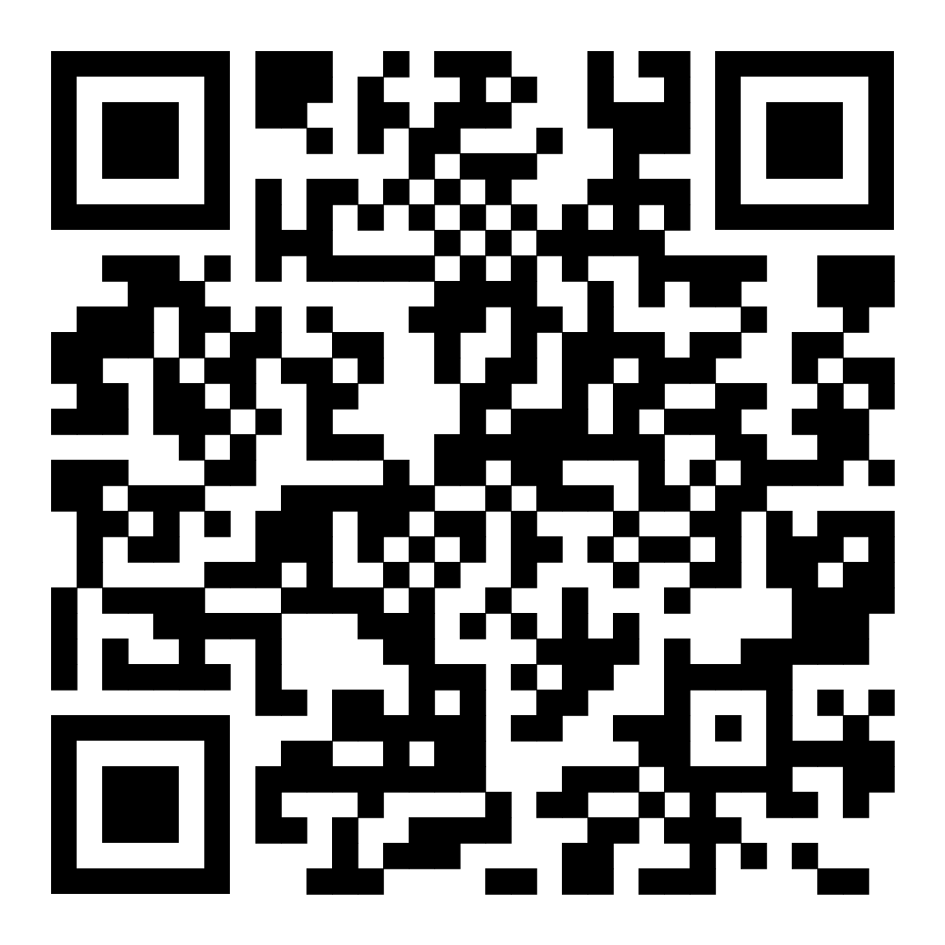
Thanks for your attention!
Scan to learn more about this project.
I am in the Job Market!
Contact: Luis Navarro lunavarr@iu.edu

Slide 18
Appendix

Slide 19
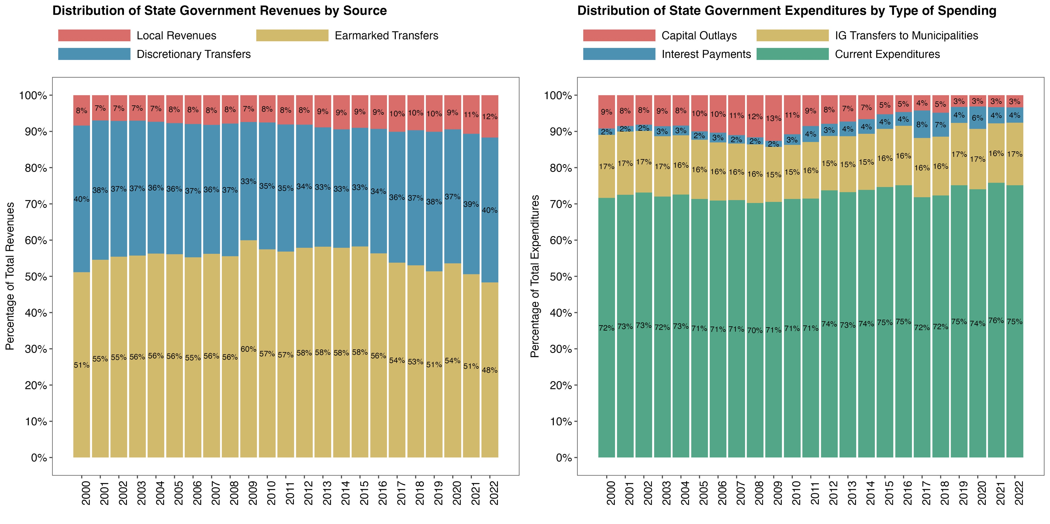
Fiscal Structure of Mexican State Governments, 2000-2022
90% of revenues come from IG transfers. 50% earmarked and 40% discretionary.
High levels of current expenditures (75%) and IG transfers to local governments (17%).
Less than 10% of spending space for capital projects, debt service, and to improve fiscal stance.
Notes: The panel on the left shows the distribution of revenues by source. Earmarked transfers (Aportaciones) include funds to finance education payroll (FONE) and infrastructure development (FAM, FAETA), health care (FASSA), social development and welfare programs (FAIS), security and policing (FASP). Discretionary transfers (Participaciones) include FGP transfers. The panel on the right shows the composition of state expenditures by type of spending. Current expenditures include payroll expenses, operating expenses and services, and transfers to state agencies and local governments. Source: INEGI.

Slide 20
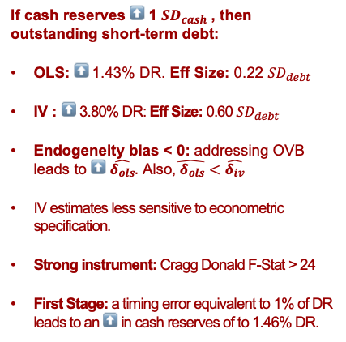
Results: Effects of Cash Reserves on Short-Term Debt
If cash reserves ⬆️ 1 $SD_{cash}$ , then outstanding short-term debt:
OLS: ⬆️ 1.43% DR. Eff Size: 0.22 $SD_{debt}$
IV : ⬆️ 3.80% DR: Eff Size: 0.60 $SD_{debt}$
Endogeneity bias < 0: addressing OVB leads to ⬆️ $\hat{δ_{ols}}.$ Also,$\hat{{ δ}_{ols}}<\hat{δ_{iv}}$
IV estimates less sensitive to econometric specification.
Strong instrument: Cragg Donald F-Stat > 24
First Stage: a timing error equivalent to 1% of DR leads to an ⬆️ in cash reserves of to 1.46% DR.
 | (1) | (2) | (3) | (4)
Panel A: OLS
Cash Reserves (% DR) δˆ | -0.152*** | -0.043 | 0.067* | 0.093**
 | (0.030) | (0.031) | (0.036) | (0.036)
Panel B: 2SLS
Cash Reserves (% DR) δˆ | 0.194 | 0.325 | 0.211* | 0.246**
 | (0.149) | (0.200) | (0.107) | (0.107)
First Stage: Timing Error βˆ | 1.565** | 1.131** | 1.661*** | 1.467***
 | (0.573) | (0.454) | (0.415) | (0.365)
Cragg-Donald F-Statistic | 7.4171 | 6.9449 | 30.0677 | 24.2066
Short-Term Debt (Mean) | 0.0519 | 0.0519 | 0.0519 | 0.0519
Short-Term Debt (SD) | 0.0635 | 0.0635 | 0.0635 | 0.0635
Cash Reserves (SD) | 0.1548 | 0.1548 | 0.1548 | 0.1548
Num.Obs. | 597 | 597 | 597 | 597
Controls | No | Yes | No | Yes
State FE | No | No | Yes | Yes
Quarter-by-Year FE | Yes | Yes | Yes | Yes
Notes: Panel A shows the results of estimating Equation 7 with an OLS estimator across several specifications. Panel B displays the results from estimating Equation 9 with a 2SLS estimator using the timing error as instrument for cash reserves. All the dependent, independent, and instrumental variables are expressed as a percentage of each state’s average discretionary revenues (DR) from 2009-2016. Time FE = Quarter-Year FE. Standard errors clustered by state. Significance level: +p < 0.10, *p < 0.05 , ** p < 0.01 , *** p < 0.001

Slide 21
Robustness Checks: Heckman Selection Model
Table: Heckman Selection Model: Short-Term Borrowing and Cash Reserves
 | (1) | (2) | (3) | (4)
Panel A: Second Stage (Outcome Model)
Cash Reserves (% DR) | –0.0716*** | –0.0109 | 0.0552** | 0.0909***
 | (0.0254) | (0.0258) | (0.0263) | (0.0268)
Panel B: First Stage (Selection Model)
Timing Error (% DR) | 19.0228** | 19.0228** | 19.0228** | 19.0228**
 | (8.1516) | (8.1516) | (8.1516) | (8.1516)
Mean Dep Var | 0.0519 | 0.0519 | 0.0519 | 0.0519
Std.Dev. Dep Var | 0.0635 | 0.0635 | 0.0635 | 0.0635
Num.Obs. | 597 | 597 | 597 | 597
Controls | No | Yes | No | Yes
State FE | No | No | Yes | Yes
Time FE | Yes | Yes | Yes | Yes
Summary:
OLS: ≈ ⬆️ 7−9 bps, 0.12-0.17x SD. Upper bound: 47 bps (0.9xSD).
Endogeneity bias < 0
2SLS IV : ≈ ⬆️
Effect Size:
IV estimates less sensitive to econometric specification.
Notes: These panels show the results from estimating Equation 9 across different subsets of the data set. In this case, with observations from each quarter of the calendar year. All coefficients correspond to the 2SLS specification with controls, state and quarter-by-year fixed effects. All the dependent, independent, and instrumental variables are expressed as a percentage of each state’s average discretionary revenues (DR) from 2009-2016. Time FE = Quarter-Year FE. Standard errors clustered by state. Significance level: +p < 0.10, *p < 0.05 , ** p < 0.01 , *** p < 0.001

Slide 22
Thought Experiment
Your employer gives the schedule of the monthly disbursements of your paycheck.
However, your monthly payment depends on the level of sales observed each month.
Hence, each month you might observe deviations from your budgeted disbursement.
The catch: observed sales (and the deviations) neither depend on your decisions nor performance.
These deviations are hard to anticipate. For you: arguably, as good as random.
Would you finance these gaps with your savings (cash reserves) or with your credit card (short-term debt)?
Notes:
I study the quasi-experimental setting created by the CRF using the intuition behind a Regression Discontinuity Design.

Slide 23
Data
Financial Variables (Cash and Debt): text-scraped from state-reported forms submitted to the Ministry of Finance. State-by-quarter variation. Consistent data begins in 2018.
Fiscal Variables (Revenues, Expenditures): annual survey of state and local government finances. State-by-year variation.
Credit Ratings: web-scraped from Fitch Ratings website. State-by-quarter variation.
Control Variables: National Statistics Agency (INEGI) surveys on employment and IRS data on number of active taxpayers. State-by-quarter variation.
Final Sample: quarterly observations for 30 states between 2018-2022.
Note: Tlaxcala and Mexico City are excluded from the analysis as they are subject to different fiscal rules.
Notes:
I study the quasi-experimental setting created by the CRF using the intuition behind a Regression Discontinuity Design.

Slide 24
Descriptive Statistics
 | Mean | Std.Dev. | Min | P25 | P50 | P75 | Max
DepVar: Short-Term Debt (% DR) | 0.0519 | 0.0635 | 0.0000 | 0.0000 | 0.0244 | 0.0940 | 0.2890
EndVar: Cash Reserves (% DR) | 0.2289 | 0.1548 | -0.0157 | 0.1174 | 0.1897 | 0.3117 | 0.9322
InstVar: Timing Error (% DR) | -0.0043 | 0.0235 | -0.1135 | -0.0185 | -0.0039 | 0.0075 | 0.0848
FGP Annual Difference (%DR, Lag = 1yr) | -0.0130 | 0.0655 | -0.2141 | -0.0641 | -0.0114 | 0.0484 | 0.0964
Net Operating Balance (% Rev, Lag = 1yr) | -0.0623 | 0.1261 | -0.7499 | -0.0833 | -0.0296 | 0.0006 | 0.0853
Current Expenditures (% Exp, Lag = 1 yr) | 0.7375 | 0.0600 | 0.4278 | 0.7121 | 0.7515 | 0.7775 | 0.8212
Discretionary Revenues (% Rev, Lag = 1yr) | 0.4766 | 0.0781 | 0.3016 | 0.4186 | 0.4731 | 0.5394 | 0.6562
Long Term Debt (% Debt, Lag = 1yr) | 0.6726 | 0.5133 | 0.0000 | 0.2834 | 0.5727 | 0.8585 | 2.2558
Credit Rating | 3.1273 | 1.0700 | 1.0000 | 3.0000 | 3.0000 | 4.0000 | 6.0000
FGP as Collateral (% Total, Lag = 1 yr) | 0.5332 | 0.2163 | 0.0880 | 0.3317 | 0.5477 | 0.7500 | 1.0000
Unemployment Rate | 0.0346 | 0.0129 | 0.0081 | 0.0259 | 0.0326 | 0.0401 | 0.0978
Active Taxpayers (% Population) | 0.5574 | 0.1015 | 0.2840 | 0.4850 | 0.5565 | 0.6376 | 0.7356
Age < 18 (% Population) | 0.0584 | 0.0040 | 0.0518 | 0.0554 | 0.0578 | 0.0606 | 0.0724
Age 19-35 (% Population) | 0.0438 | 0.0022 | 0.0405 | 0.0425 | 0.0433 | 0.0449 | 0.0514
Age 36-65 (% Population) | 0.0847 | 0.0047 | 0.0691 | 0.0814 | 0.0858 | 0.0882 | 0.0924
Notes: This panel shows the descriptive statistics of the main variables used for the analysis. N= 597 for all variables. The first two columns show the sample mean and standard deviation. P25, P50 and P75 show the 25, 50 and 75 percentiles, respectively. Credit rating is coded such that a higher number is associated with a higher credit rating. Considering the distribution of ratings I grouped them in 3 categories AAA,AA = 1, A = 2, and BBB,BB,NR = 3. Short-Term borrowing, cash reserves, FGP budget error, and fiscal balance measures are expressed as a percentage of the average discretionary revenues (DR) observed between 2009 and 2016. That is, outside the analysis period to avoid endogeneity concerns. All these fiscal variables correspond to one-year lagged measures.

Slide 25
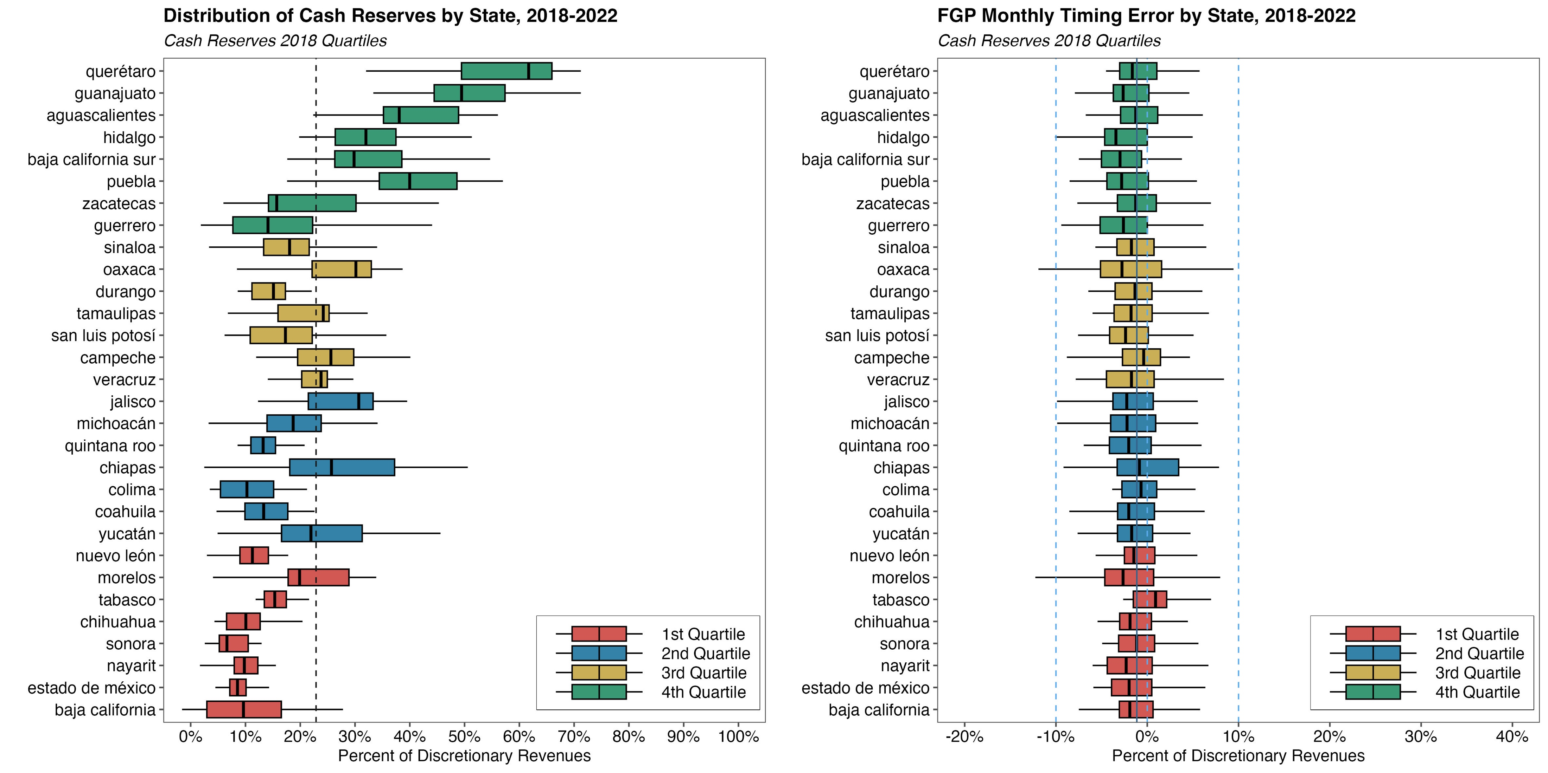
Timing errors do not seem to vary with the level of cash reserves.
Notes: Both panels shows the distribution of cash reserves (left) and FGP timing errors (right) by state across quarter-years. Each boxplot depicts the distribution by state, excluding outlier observations. States are partitioned into groups depending on quartiles of the distribution of cash reserves in FY 2018. Variables expressed as percent of discretionary revenues. For illustrative purposes, dashed blue lines on the left panel show the interval between +/- 10% of discretionary revenues.

Slide 26
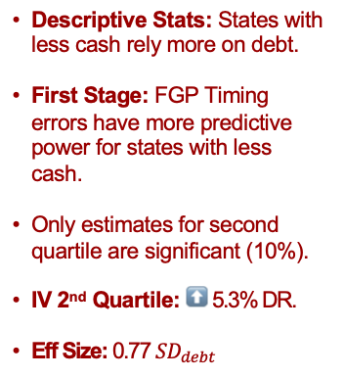
Mechanisms: Levels of Cash Reserves
Table: Effect of Cash Reserves on Short-Term Debt by Level of Cash Reserves
Descriptive Stats: States with less cash rely more on debt.
First Stage: FGP Timing errors have more predictive power for states with less cash.
Only estimates for second quartile are significant (10%).
IV 2nd Quartile: ⬆️ 5.3% DR.
Eff Size: 0.77 $SD_{debt}$
 | 1st Quartile | 2nd Quartile | 3rd Quartile | 4th Quartile
Cash Reserves (% DR) δˆ | 0.012 | 0.511+ | 0.701 | -0.287
 | (0.320) | (0.262) | (0.426) | (0.338)
First Stage: Timing Error βˆ | 1.706** | 1.677** | 0.483 | 0.445
 | (0.469) | (0.362) | (0.438) | (0.374)
Cragg-Donald F-Statistic | 7.8162 | 4.6089 | 1.3406 | 0.8011
Short-Term Debt (Mean) | 0.0699 | 0.0671 | 0.0457 | 0.0263
Short-Term Debt (SD) | 0.0596 | 0.0693 | 0.0647 | 0.0506
Cash Reserves (SD) | 0.0823 | 0.1045 | 0.0836 | 0.1849
Num.Obs. | 158 | 140 | 139 | 160
Notes: These panels show the results from estimating Equation 9 across different subsets of the data set. In this case, with the states at each quartile of the cash reserves distribution observed in 2018. All coefficients correspond to the 2SLS specification with controls, state and quarter-by-year fixed effects. All the dependent, independent, and instrumental variables are expressed as a percentage of each state’s average discretionary revenues (DR) from 2009-2016. Time FE = Quarter-Year FE. Standard errors clustered by state. Significance level: +p < 0.10, *p < 0.05 , ** p < 0.01 , *** p < 0.001

Slide 27
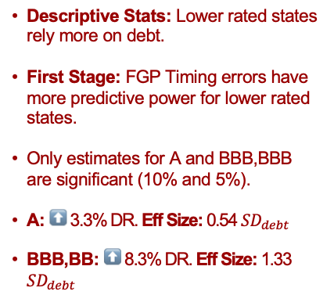
Mechanisms: Credit Quality
Descriptive Stats: Lower rated states rely more on debt.
First Stage: FGP Timing errors have more predictive power for lower rated states.
Only estimates for A and BBB,BBB are significant (10% and 5%).
A: ⬆️ 3.3% DR. Eff Size: 0.54 $SD_{debt}$
BBB,BB: ⬆️ 8.3% DR. Eff Size: 1.33 $SD_{debt}$
Table: Effect of Cash Reserves on Short-Term Debt by Credit Rating
 | AAA | AA | A | BBB,BB
Cash Reserves (% DR) δˆ | -0.041 | 0.134 | 0.293+ | 1.123*
 | (0.086) | (0.084) | (0.159) | (0.368)
First Stage: Timing Error βˆ | 1.527 | 1.335* | 1.925* | 1.551**
 | (2.402) | (0.378) | (0.741) | (0.428)
Cragg-Donald F-Statistic | 0.9127 | 4.3514 | 24.4371 | 5.5323
Short-Term Debt (Mean) | 0.0029 | 0.0121 | 0.0522 | 0.0898
Short-Term Debt (SD) | 0.0146 | 0.0261 | 0.0622 | 0.0627
Cash Reserves (SD) | 0.24 | 0.1632 | 0.1148 | 0.0744
Num.Obs. | 46 | 74 | 302 | 146
Notes: These panels show the results from estimating Equation 9 across different subsets of the data set. In this case, with the states at each quartile of the cash reserves distribution observed in 2018. All coefficients correspond to the 2SLS specification with controls, state and quarter-by-year fixed effects. All the dependent, independent, and instrumental variables are expressed as a percentage of each state’s average discretionary revenues (DR) from 2009-2016. Time FE = Quarter-Year FE. Standard errors clustered by state. Significance level: +p < 0.10, *p < 0.05 , ** p < 0.01 , *** p < 0.001

Slide 28
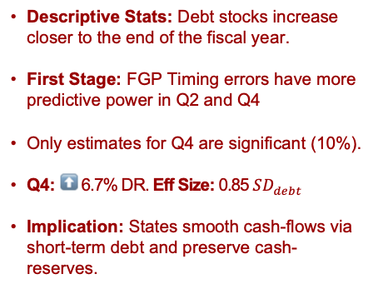
Temporal Heterogeneity and Anticipation Effects
Table: Effect of Cash Reserves on Short-Term Debt: Heterogeneity by Quarter
Descriptive Stats: Debt stocks increase closer to the end of the fiscal year.
First Stage: FGP Timing errors have more predictive power in Q2 and Q4
Only estimates for Q4 are significant (10%).
Q4: ⬆️ 6.7% DR. Eff Size: 0.85 $SD_{debt}$
Implication: States smooth cash-flows via short-term debt and preserve cash-reserves.
 | Q1 | Q2 | Q3 | Q4
Cash Reserves (% DR) δˆ | 0.120 | 0.064 | 0.489 | 0.519+
 | (0.182) | (0.103) | (0.471) | (0.305)
First Stage: Timing Error βˆ | 1.377+ | 1.296** | 1.827 | 2.737*
 | (0.693) | (0.464) | (1.156) | (1.014)
Cragg-Donald F-Statistic | 3.5495 | 11.3331 | 1.8524 | 6.33
Short-Term Debt (Mean) | 0.0569 | 0.0422 | 0.0343 | 0.0746
Short-Term Debt (SD) | 0.0605 | 0.0552 | 0.049 | 0.0787
Cash Reserves (SD) | 0.141 | 0.1625 | 0.1674 | 0.1292
Num.Obs. | 150 | 150 | 149 | 148
Notes: These panels show the results from estimating Equation 9 across different subsets of the data set. In this case, with observations from each quarter of the calendar year. All coefficients correspond to the 2SLS specification with controls, state and quarter-by-year fixed effects. All the dependent, independent, and instrumental variables are expressed as a percentage of each state’s average discretionary revenues (DR) from 2009-2016. Time FE = Quarter-Year FE. Standard errors clustered by state. Significance level: +p < 0.10, *p < 0.05 , ** p < 0.01 , *** p < 0.001

Slide 29
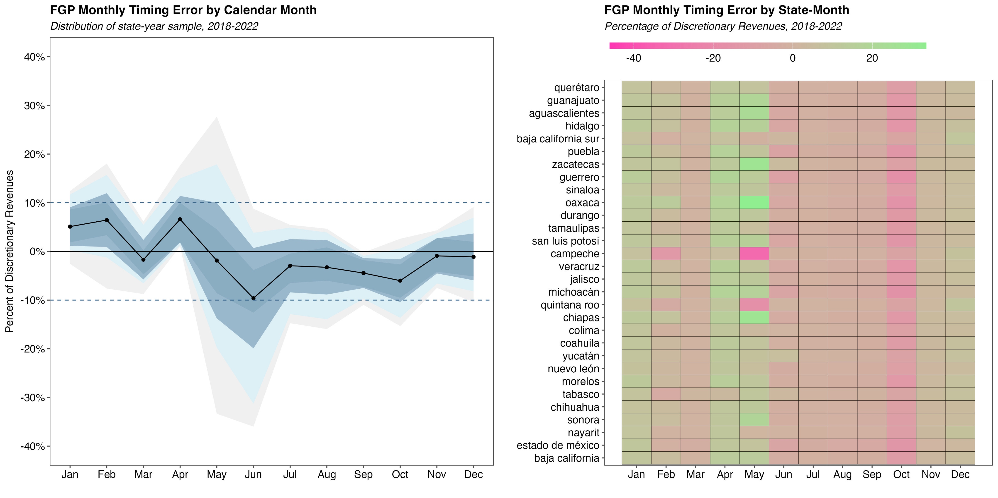
Instrument Validity: FGP Timing Errors by Calendar Month
Timing errors are in average:
Positive in Jan, Feb, Apr
Negative the rest of the year.
Lowest in Jun.
No systematic variation across states within months
States get the same draw of monthly timing errors within the same fiscal year.
Notes: The panel on the left shows the distribution of the FGP timing error for each month, across state and years. The solid line represents the mean across states by month-year. The dark-shaded area shows the percentiles between 25%-75%, as well as the area within one standard deviation form the mean, while the light-shaded areas percentiles 1% to 99% (excluding outliers) and 5%-95%. The panel on the right shows the distribution of timing errors for each state and calendar month, across year. For illustrative purposes, dashed blue lines show the interval between +/- 10% of discretionary revenues.

Slide 30
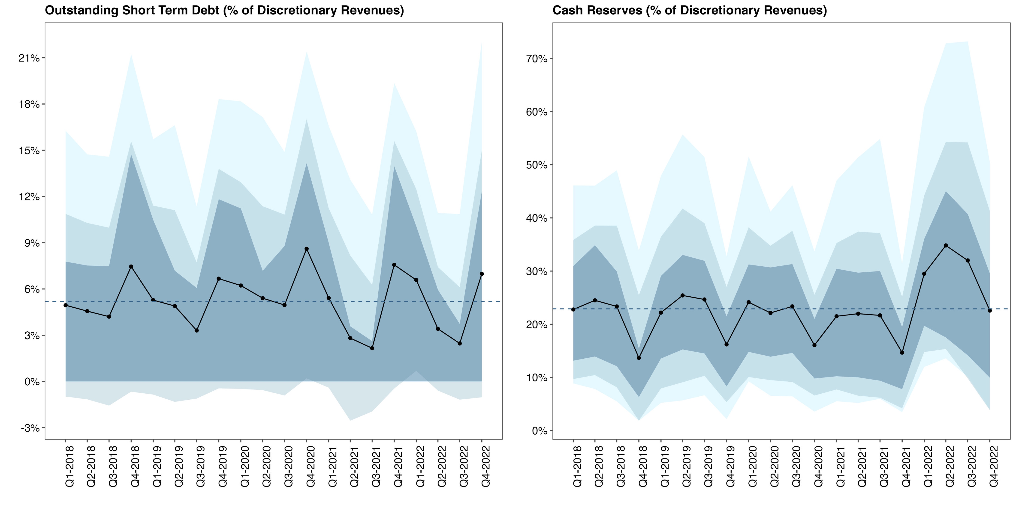
There is some 4Q seasonality on cash and short-term debt
Notes: Each panel shows the distribution of the main dependent (outstanding short-term debt, left) and independent (cash reserves) variables, both expressed as percentage of discretionary revenues. The solid line represents the mean across states by year. The dark-shaded area shows the percentiles between 25%-75%, as well as the area within one standard deviation form the mean, while the light-shaded areas percentiles 1% to 99% (excluding outliers) and 5%-95%.

Slide 31
Instrument Validity
Alternative Instrumental Variables: budget errors on other IG transfers: i) all discretionary transfers, ii) earmarked transfers, and iii) all IG transfers.
Result: other instruments are weak and/or pose a violation of exclusion restriction. FGP errors are the best candidate to address endogeneity.
Notes:
I study the quasi-experimental setting created by the CRF using the intuition behind a Regression Discontinuity Design.

Slide 32
Alternative IV: Effects of Cash Reserves on Short-Term Debt
IV: Discretionary Revenues Timing Error
Cash Reserves (% DR) δˆ | -0.040 | 0.048 | 0.002 | 0.037
 | (0.116) | (0.111) | (0.072) | (0.087)
First Stage: Timing Error βˆ | 1.282** | 0.837** | 0.968*** | 0.829***
 | (0.456) | (0.267) | (0.240) | (0.211)
Cragg-Donald F-Statistic | 21.5163 | 15.9941 | 38.1511 | 28.4921
IV: Earmarked Revenues Timing Error
Cash Reserves (% DR) δˆ | 0.150 | 0.433 | 0.434 | 0.435
 | (1.604) | (0.660) | (0.332) | (0.345)
First Stage: Timing Error βˆ | -0.163 | -0.287 | -0.303 | -0.301
 | (0.374) | (0.254) | (0.206) | (0.237)
Cragg-Donald F-Statistic | 0.2911 | 1.5095 | 3.0999 | 3.3204
IV: IG Transfers Timing Error
Cash Reserves (% DR) δˆ | -0.064 | -0.103 | -0.163 | -0.163
 | (0.259) | (0.340) | (0.273) | (0.351)
First Stage: Timing Error βˆ | 0.576+ | 0.317 | 0.373+ | 0.287
 | (0.316) | (0.228) | (0.197) | (0.189)
Cragg-Donald F-Statistic | 8.41 | 4.2607 | 10.149 | 6.3185
Mean Dep Var | 0.0519 | 0.0519 | 0.0519 | 0.0519
Std.Dev. Dep Var | 0.0635 | 0.0635 | 0.0635 | 0.0635
Num.Obs. | 597 | 597 | 597 | 597
Controls | No | Yes | No | Yes
State FE | No | No | Yes | Yes
Discretionary IG Transfers have predictive power, yet estimates are smaller and noisy.
Challenge: this instrument might violate the exclusion restriction.
Earmarked and all IG transfers: weak instruments.
Takeaway: FGP timing errors are the best candidate for exogenous variation.
Notes: This table show the results from estimating baseline model through 2SLS using different instrumental variables. First stage coefficients are also reported. All the dependent, independent, and instrumental variables are expressed as a percentage of each state’s average discretionary revenues (DR) from 2009-2016. Time FE = Quarter-Year FE. Standard errors clustered by state. Significance level: +p < 0.10, *p < 0.05 , ** p < 0.01 , *** p < 0.001

Slide 33
Mechanisms
Level of Cash Reserves: the stringency of liquidity constraints could shift the relationship between cash and debt.
Credit Quality: lower rated governments might experience more stringent liquidity constraints. Governments might hoard cash to maintain creditworthiness (Marlowe, 2011).
FY Stage: liquidity constrains might increase towards the end of the FY as liquidity management strategies are mainly implemented during this period.
Notes:
I study the quasi-experimental setting created by the CRF using the intuition behind a Regression Discontinuity Design.

Slide 34
Policy Implications
Opportunity cost of debt: borrowing costs + return on savings not earned.
Welfare losses are accentuated if governments must invest savings in AAA assets. Intermediation spread might be larger for lower rated governments.
Liquidity management tools could alleviate the welfare costs associated with under-capitalized governments.
Cash and debt behave like complements for less capitalized governments, and like substitutes for highly-capitalized governments.
Implication: there exists a level of cash reserves at which governments might be indifferent. Key to avoid idle assets (Kling, 2018).
Lessons from institutional setting: shared-revenue systems could lead to fiscal spillovers that translate into liquidity shocks for subnational governments.

Slide 35
Cash Reserves and Short-Term Debt Under Liquidity Constraints
O’Neill School of Public and Environmental Affairs
Luis Navarro
Practice Presentation
INDIANA UNIVERSITY BLOOMINGTON

